Slide 1

Introduction to Databases
STW220CT: Data and Information Retrieval
Prepared By : Kiran Rana

Slide 2
Module Assessment
Coursework - Practical and theoretical report ( 50%)
Exam, 2 hours ( 50%)

Slide 3
Module Expected outcomes
On completion of this module the student should be able to:
Explain the difference between data and information and its significance as a business resource.
Identify the main advantages and disadvantages of different approaches to database and information retrieval systems.
Capacity to understand and apply the components of the data mining lifecycle to real-world big data problems.
Analyse, design, implement and manage a database solution for a specified data and information retrieval problem
Demonstrate understanding of Big Data as a concept and as a business tool through the application of data analysis techniques.
Understand the fundamentals of NoSQL Databases.

Slide 4



Data Base
Data: Facts and figures
Base: Store
Database: A store of data

Slide 5

Database
A
Store
for
data
Notes:
Database
A store of data

Slide 6
Databases Software
Database Software for this module
Teach transferable skills not software
We use industry standards
DBMS Oracle 12c
Query language SQL
Why not MS Access
Not a DMBS, therefore not comparable
No concurrency, transaction control or scalability
Small scale business tool used for different tasks
Microsoft’s comparable to Oracle is SQLServer not Access
Notes:
ANSI SQL is a transferable skill
Once learnt the tool can be applied to other Databse eg
Sysbase, Dbase SQLServer – Current market standards
MySQL, ProgreSQL – freeware
BDW in-house database build based on SQL

Slide 7
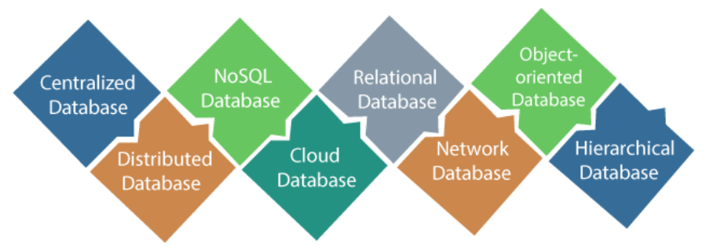
Types of Database

Slide 8
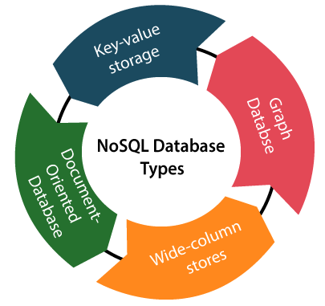
NoSQL database types

Slide 9
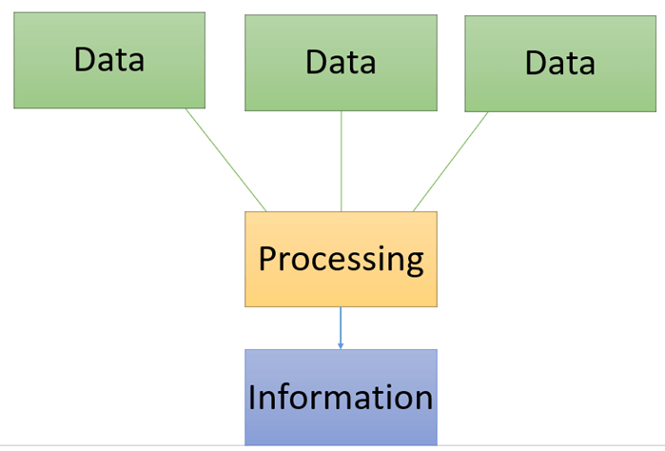
Data and Information
Data is a raw and unorganized fact that required to be processed to make it meaningful. Data can be simple at the same time unorganized unless it is organized. Generally, data comprises facts, observations, perceptions numbers, characters, symbols, image, etc.
Information is a set of data which is processed in a meaningful way according to the given requirement. Information is processed, structured, or presented in a given context to make it meaningful and useful.

Slide 10
What is SQL ?
SQL (pronounced "ess-que-el") stands for Structured Query Language. SQL is used to communicate with a database. According to ANSI (American National Standards Institute), it is the standard language for relational database management systems.
SQL statements are used to perform tasks such as update data on a database, or retrieve data from a database.
Some common relational database management systems that use SQL are: Oracle, Sybase, Microsoft SQL Server, Access, Ingres, etc.

Slide 11
SQL Categories
SQL categories
DDL (Data Definition Language)
DML (Data Manipulation Language)
DQL(Data Query Language).
DCL(Data Control Language).
TCL(Transaction Control Language).

Slide 12
DDL (Data Definition Language)
Data definition language (DDL) statements let you to perform these tasks:
Create, alter, and drop schema objects
Grant and revoke privileges and roles
Analyze information on a table, index, or cluster
Establish auditing options
Add comments to the data dictionary

Slide 13
DML (Data Manipulation Language)
Data manipulation language (DML) statements access and manipulate data in existing schema objects. These statements do not implicitly commit the current transaction. The data manipulation language statements are:
CALL
EXPLAIN PLAN
INSERT
LOCK TABLE
MERGE
SELECT
UPDATE
DELETE

Slide 14

Oracle

Slide 15
Datatypes in Oracle

Slide 16
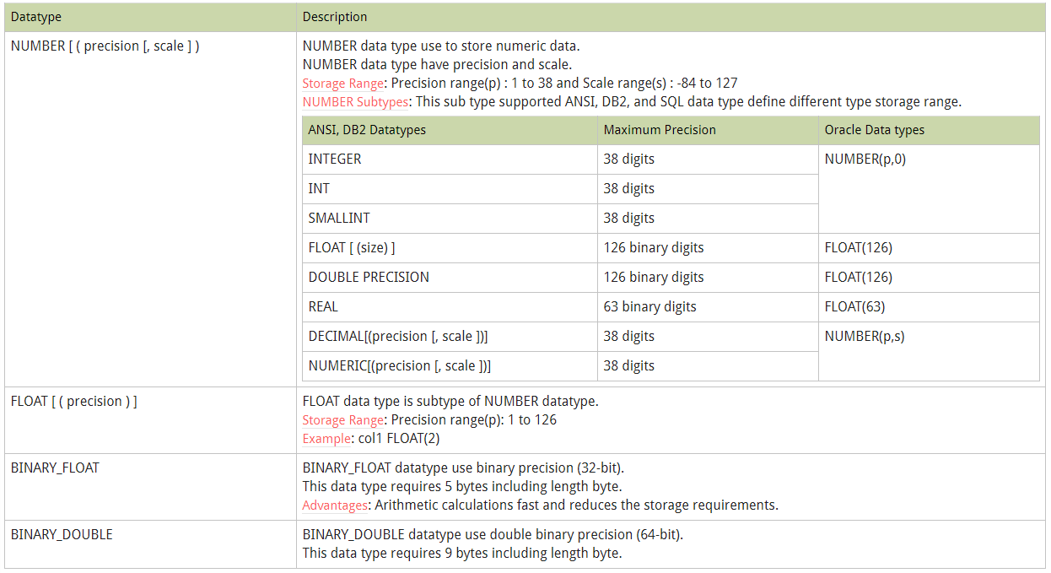
Number Datatypes

Slide 17
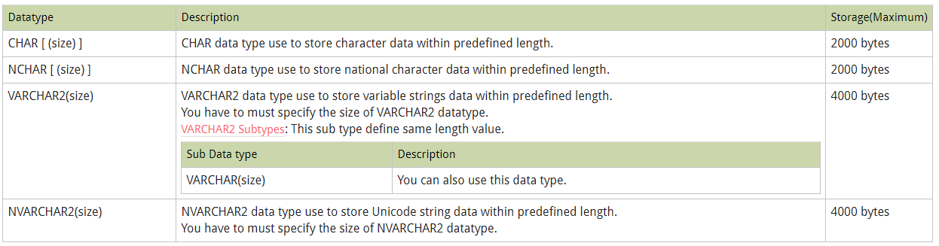
Character Datatypes

Slide 18
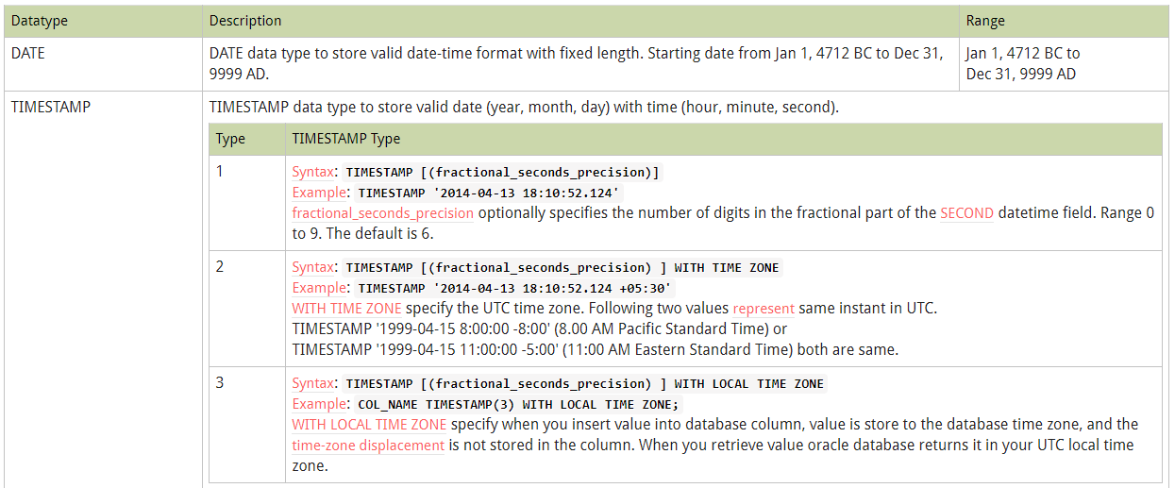
Date/Time datatypes

Slide 19
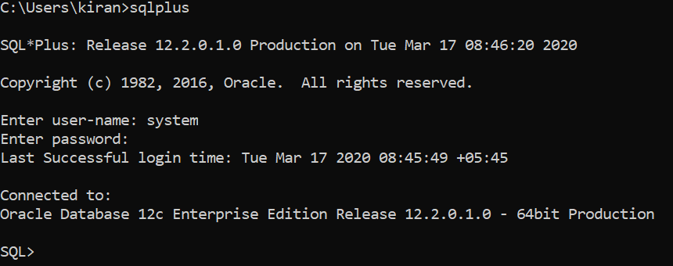
SQLPlus
Go to command prompt and type sqlplus

Slide 20
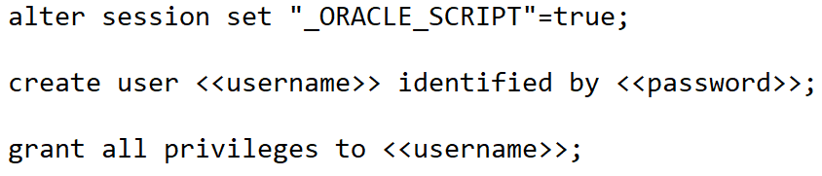
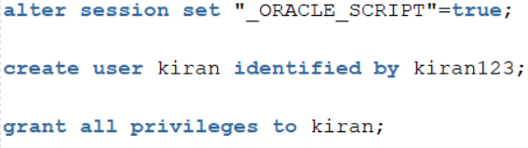
Create user in Oracle 12c

Slide 21
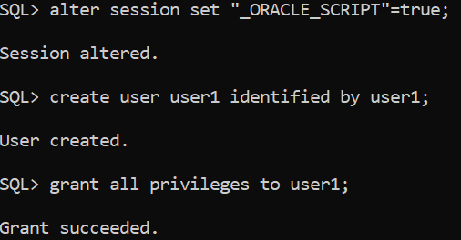
Create user in Oracle 12c

Slide 22
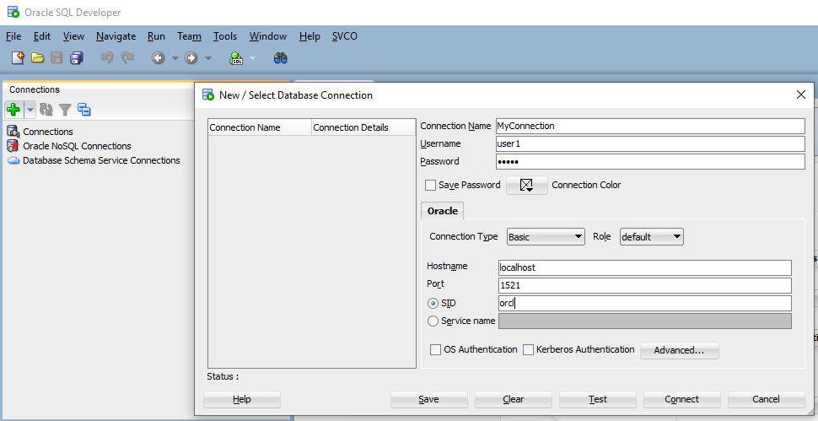
SQL Developer
Click add
button
username
password
Change xe to orcl

Slide 23
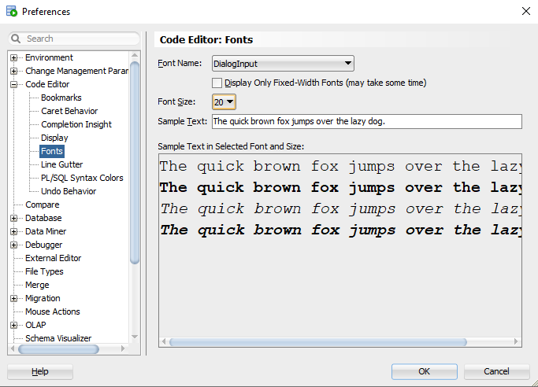
Change the font size
Go to tool->preferences

Slide 24
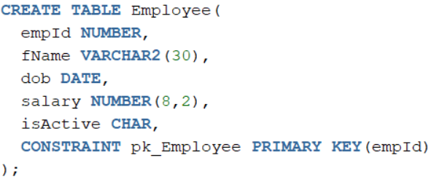
Create table in Oracle

Slide 25
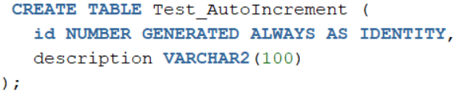
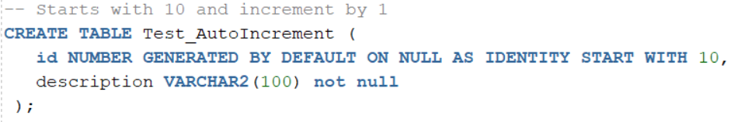
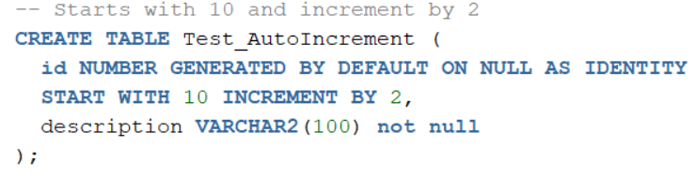
Auto Increment in Oracle

Slide 26
Auto Increment in Oracle

Slide 27
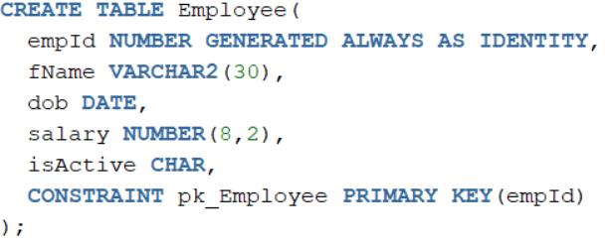
Create table in Oracle

Slide 28

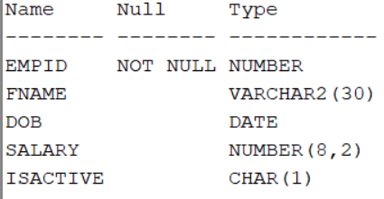
Metadata
Oracle Database provides information about all of the tables, views, columns, and
procedures in a database.
This information about the information is known as metadata.
It is stored in two locations:
data dictionary tables and
a metadata registry

Slide 29
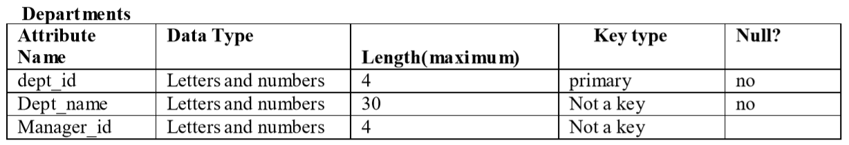
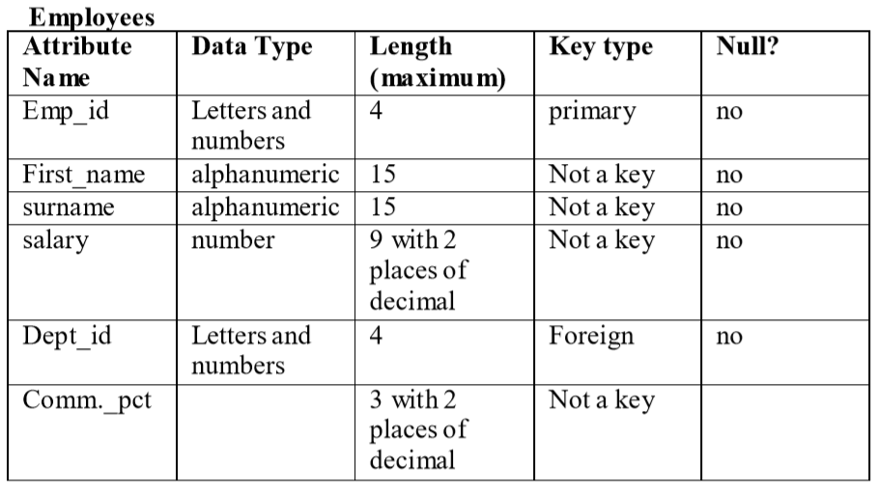
Classwork – Create a following table

Slide 30
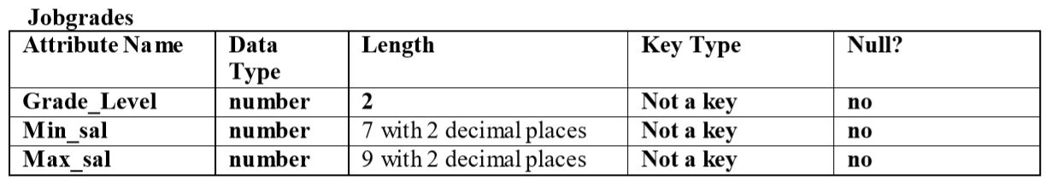
Classwork – Create a following table

Slide 31
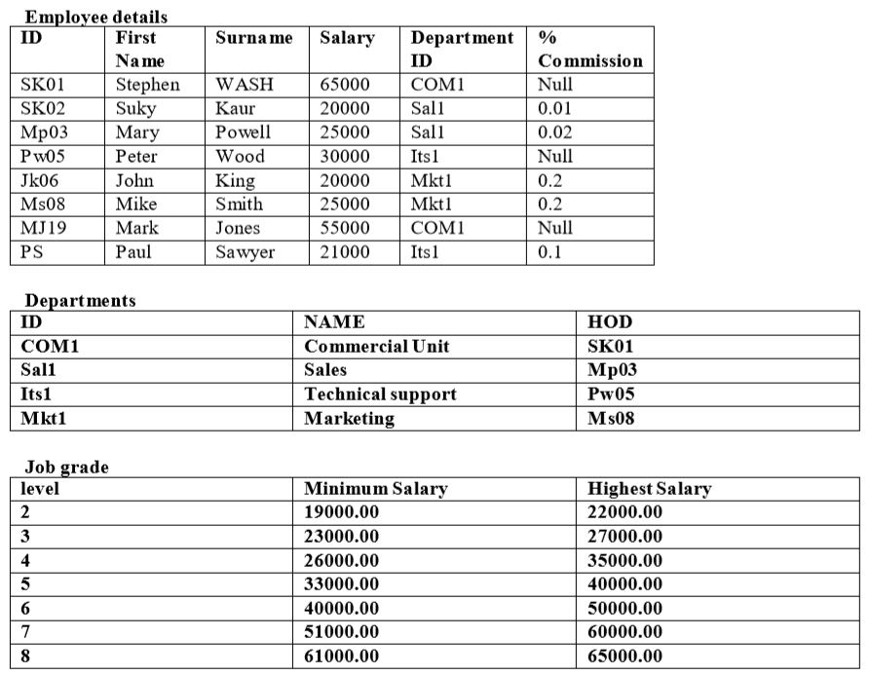
Insert the following data

Slide 32
Questions
Write a query to display all employee details with their related departments.
Write a query to find the job grade of ‘Mark Jones’.
Write a query to find how many employee works in COM1 department.
Write a query to find the lowest salary in ‘Sal1’ department.
Write a query to find the number of employees working in each department.
Write a query to display the first name and department name of the highest salaried employee.

Slide 33
Normalization
Normalization is a database design technique that organizes tables in a manner that reduces redundancy and dependency of data. Normalization divides larger tables into smaller tables and links them using relationships.
The purpose of Normalization is to eliminate redundant (useless) data and ensure data is stored logically.
Database Normal Forms

Slide 34
Normal forms
Un-normalized : There are multivalued attributes or repeating groups
1 NF – No multivalued attributes or repeating groups.
2 NF – 1 NF plus no partial dependencies
3 NF – 2 NF plus remove non-Key dependencies or transitive dependencies

Slide 35
Billing System
Bill No.: 1078
Date: 2013-12-20
Customer Code: C100
Customer Name: Ram Shrestha
ItemCode | ItemName | Rate | Qty
1 | Copy | 20 | 10
2 | Book | 200 | 8
3 | Pen | 10 | 3

Slide 36
UNF (Un-Normalized Form)
UNF | UNF Level
BillNo | 1
Date | 1
CustomerCode | 1
CustomerName | 1
ItemCode | 2
ItemName | 2
Rate | 2
Qty | 2
The first step is to identify which attributes belong to the repeating group.
Those attributes where there is one occurrence are marked with a ‘1’.
Those attributes where there is a repeating group are marked with a ‘2’.
The tentative primary key is also underlined. In this case it is BillNo.

Slide 37
First Normal Form (1NF)
Remove Repeating Group Information
BillNo
Date
CustomerCode
CustomerName
BillNo
ItemCode
ItemName
Rate
Qty

Slide 38
Second Normal Form (2NF)
Remove Partial Key Dependencies
Identify the attributes that are dependent on only one part of the primary key (composite key) and separate them.
BillNo
Date
CustomerCode
CustomerName
ItemCode
ItemName
Rate
BillNo
ItemCode
Qty

Slide 39
Third Normal Form (3NF)
Remove Non-Key Dependencies or Transitive Dependencies
Identify the attributes that are functionally dependent on non-key attributes or identify the attributes that are not functionally dependent on primary key.
Here CustomerName is dependent of CustomerCode not BillNo
BillNo
Date
CustomerCode
CustomerCode
CustomerName
BillNo
ItemCode
Qty
ItemCode
ItemName
Rate

Slide 40
Final ER
BillNo
Date
CustomerCode
BillNo
ItemCode
Qty
ItemCode
ItemName
Rate
1
M
M
1
M
1
CustomerCode
CustomerName

Slide 41
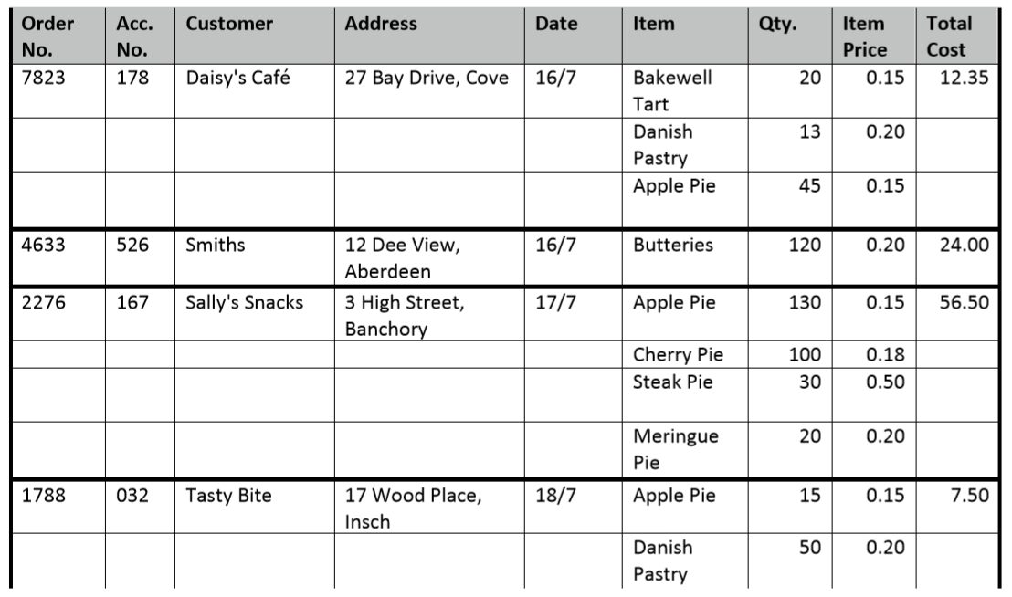
Normalization : question

Slide 42
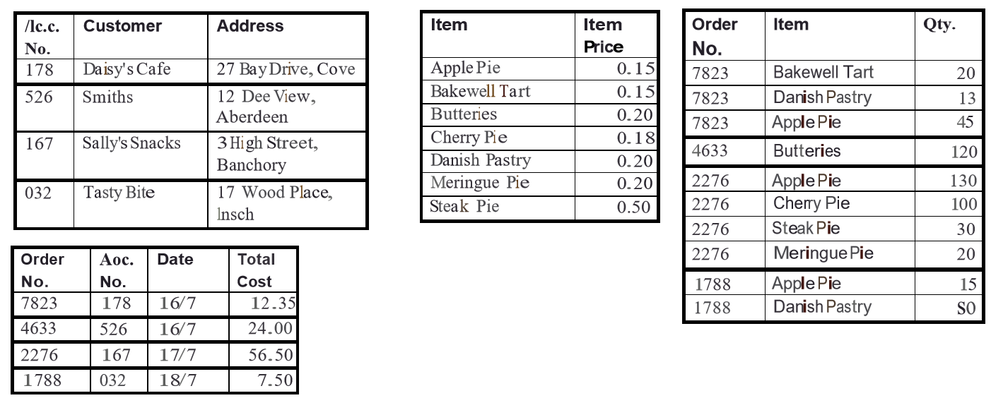
Solution

Slide 43
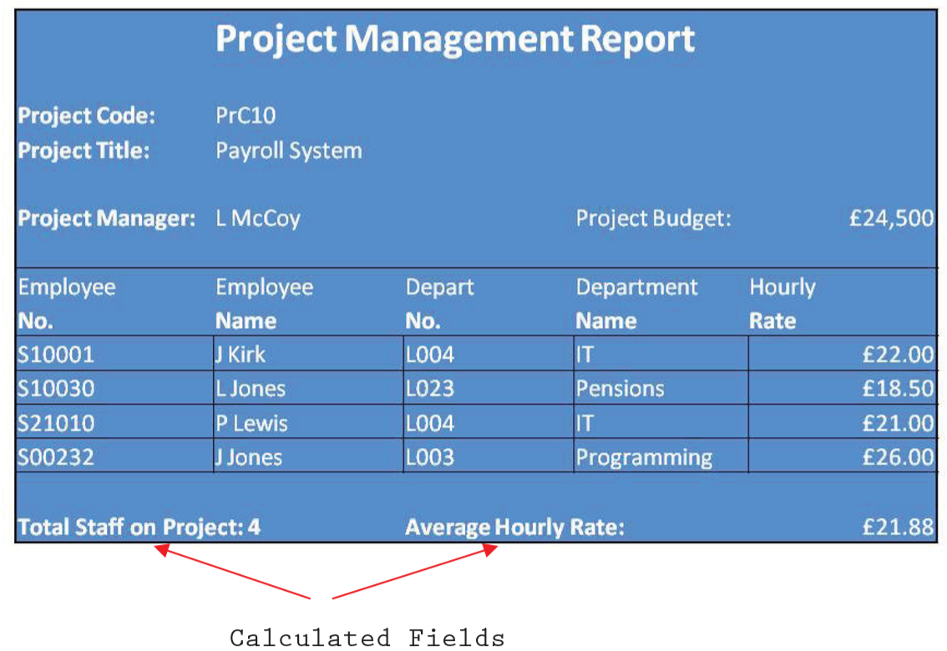
Normalization : question

